Slide 1
Problems Related To PCM and DM

Slide 2
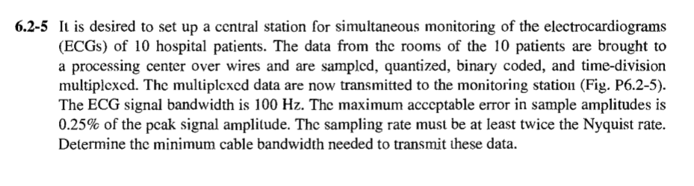
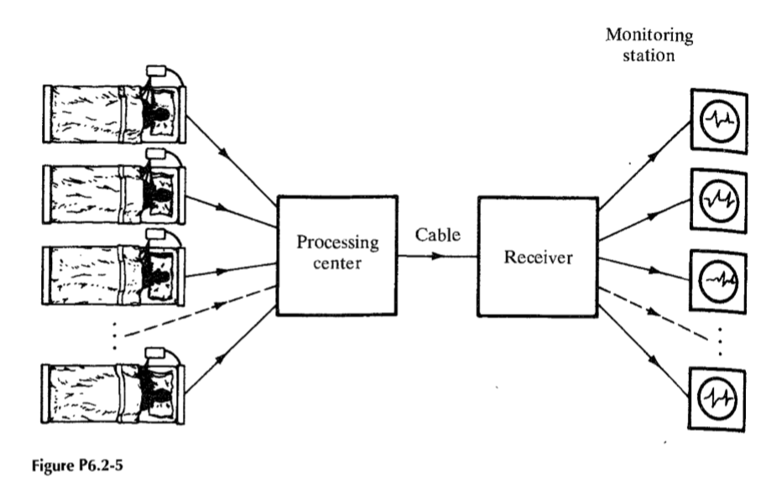
BP Lathi Exercise 6.2-5

Slide 3
A DM system is designed to operate at 3 times the Nyquist rate for a signal with a 3kHz bandwidth. The quantizing step size is 250mV.
Determine maximum amplitude of a 1kHz input for which the delta modulator does not show slope overload.
Determine post filtered SNR for the signal of part(1).

